Slide 1
Neural Radiance Field with Refraction
Zhangkaiwen Chu

Slide 2
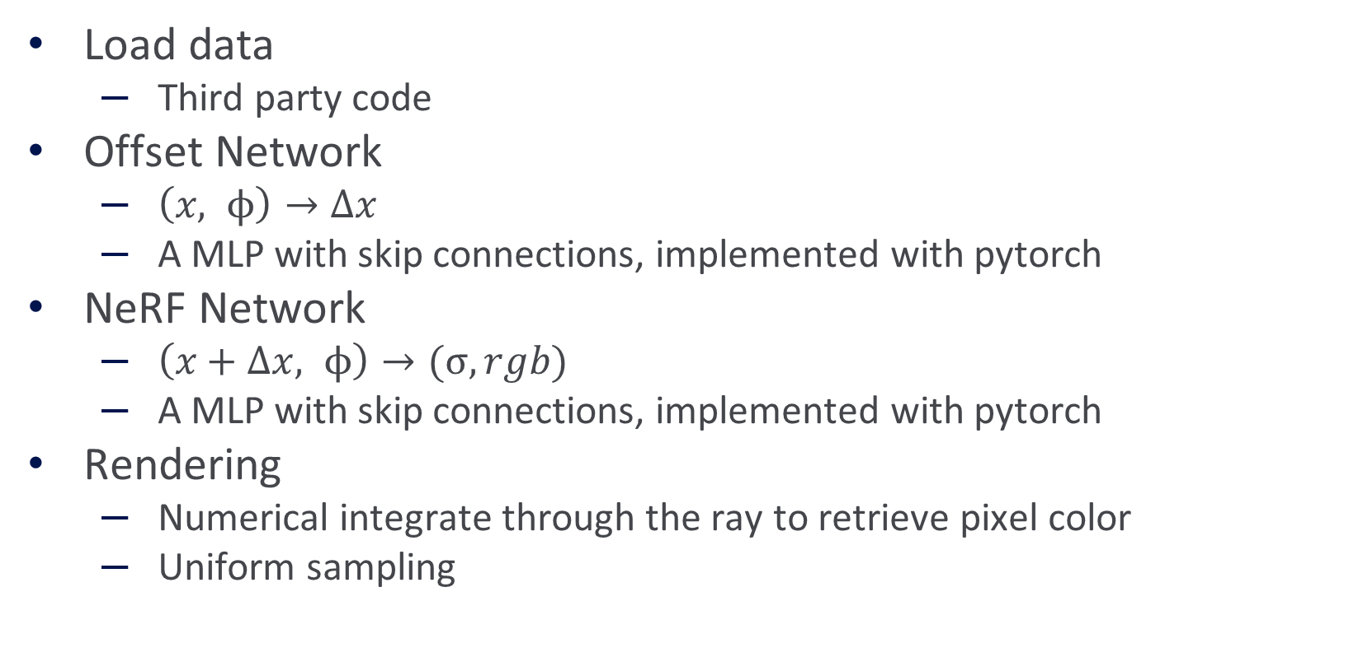
Previous Progress
Load data
Third party code
Offset Network
$\left(x, ϕ\right)→Δx$
A MLP with skip connections, implemented with pytorch
NeRF Network
$\left(x+Δx, ϕ\right)→(σ, rgb)$
A MLP with skip connections, implemented with pytorch
Rendering
Numerical integrate through the ray to retrieve pixel color
Uniform sampling

Slide 3
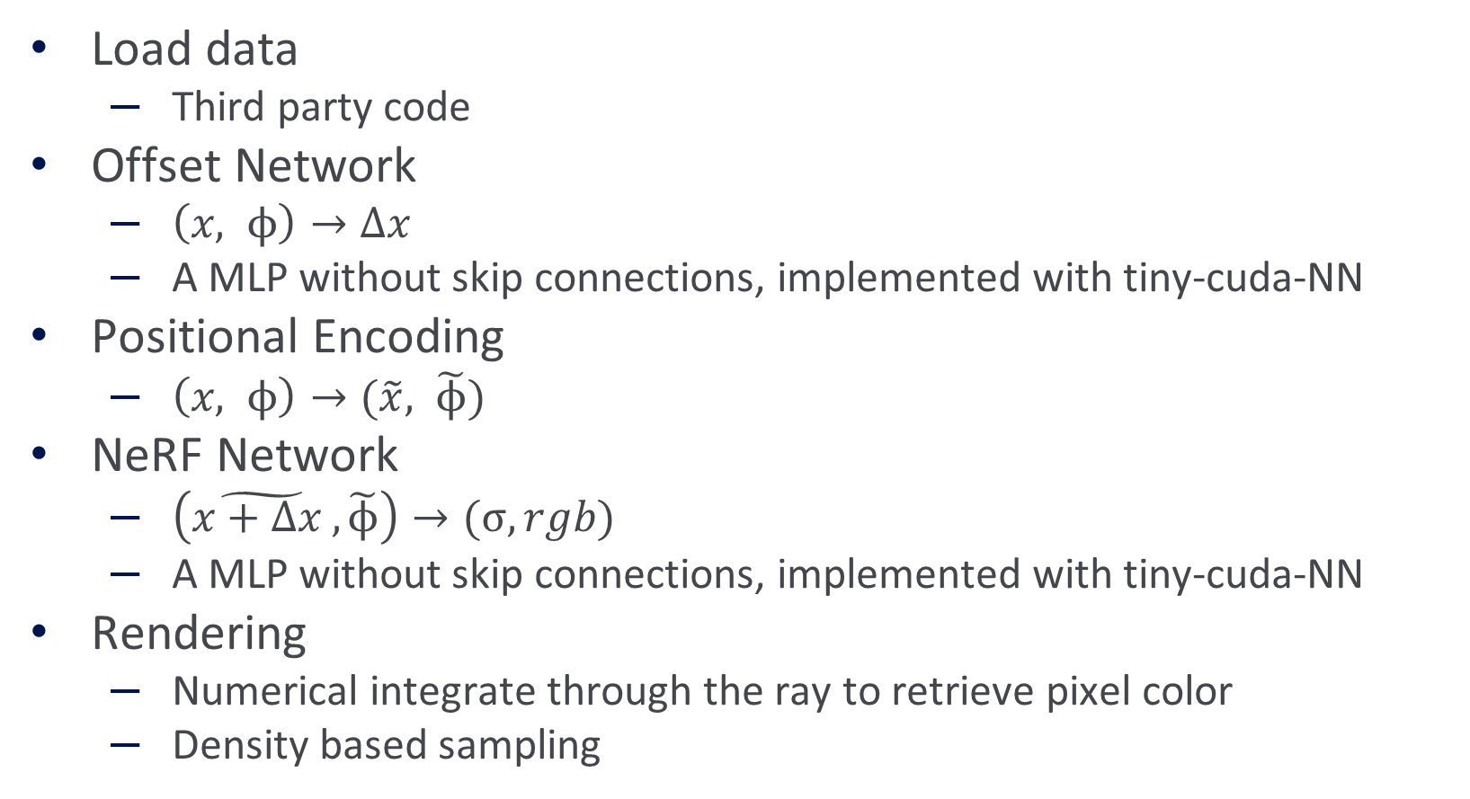
Current Progress
Load data
Third party code
Offset Network
$\left(x, ϕ\right)→Δx$
A MLP without skip connections, implemented with tiny-cuda-NN
Positional Encoding
$\left(x, ϕ\right)→(\tilde{x}, \tilde{ϕ})$
NeRF Network
$\left(\tilde{x+Δx },\tilde{ϕ}\right)→(σ, rgb)$
A MLP without skip connections, implemented with tiny-cuda-NN
Rendering
Numerical integrate through the ray to retrieve pixel color
Density based sampling

Slide 4
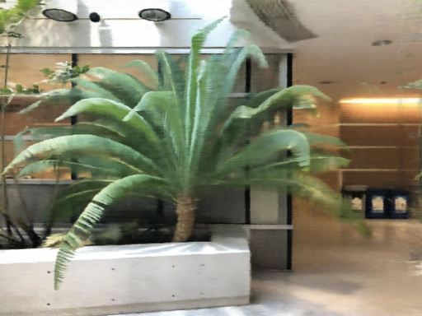

Results
NeRF with positional encoding
LB-NeRF with positional encoding

Slide 5
Future Milestones
11/28 – 12/11:
Hyperparameter tuning
Implement a Cuda version with tiny cuda nn

Slide 6

Bloopers
LB-NeRF without weight decay and L2-regularization

